Slide 1
ggplot2 tutorial for plotting in R

Slide 2
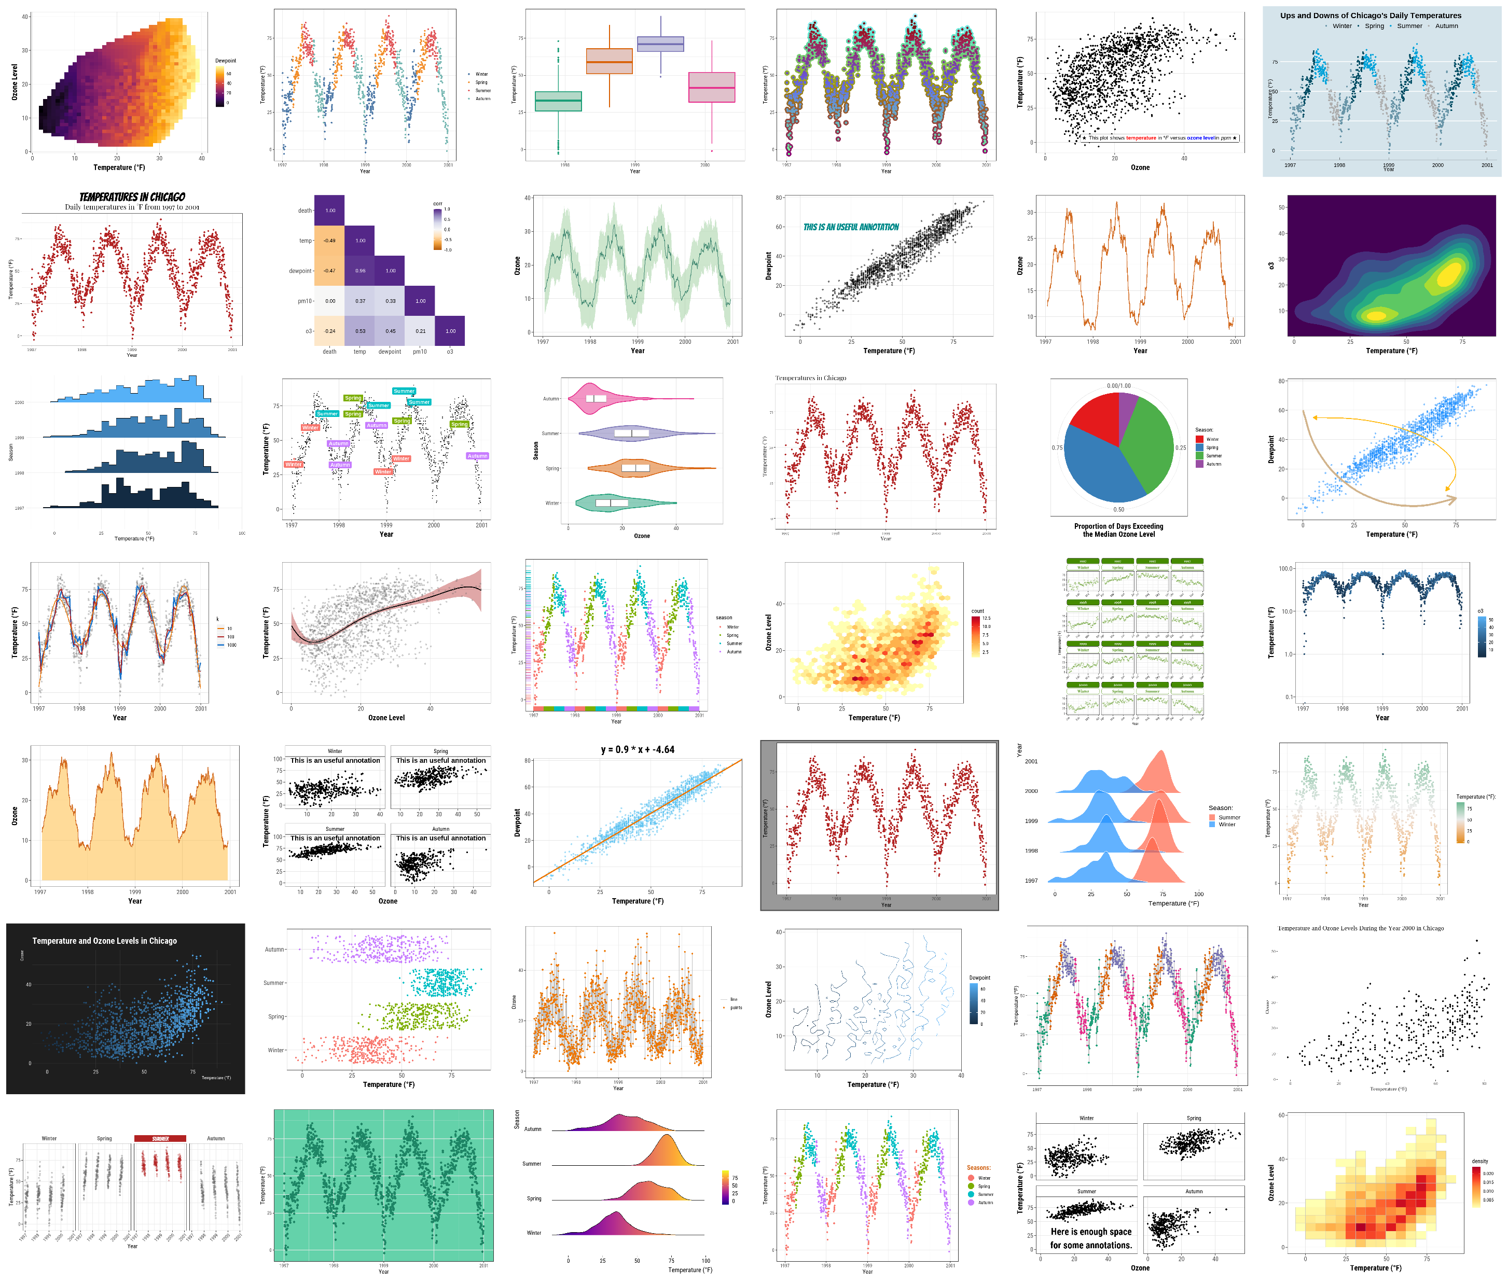

Slide 3
Table of Content
Preparation
The Dataset
The {ggplot2} Package
A Default ggplot
Working with Axes
Working with Titles
Working with Legends
Working with Backgrounds & Grid Lines
Working with Margins
Working with Multi-Panel Plots
Working with Colors
Working with Themes
Working with Lines
Working with Text
Working with Coordinates
Working with Chart Types
Working with Ribbons (AUC, CI, etc.)
Working with Smoothings
Working with Interactive Plots
Remarks, Tipps & Resources

Slide 4
Preparation
install.packages(“ggplot2”)
Library(ggplot2)

Slide 5
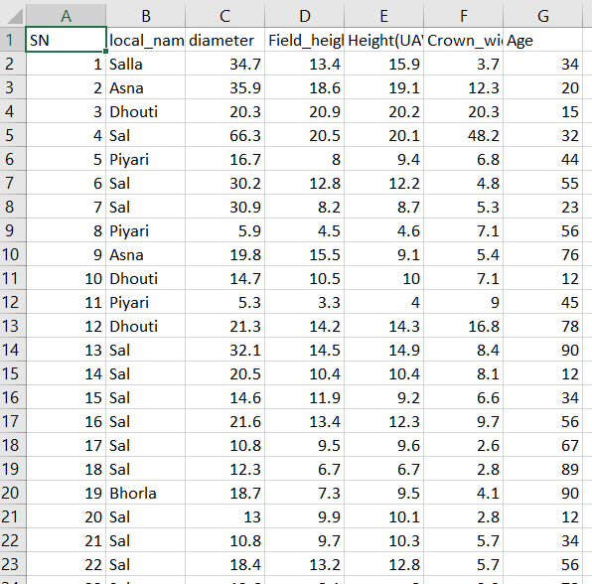
The Dataset
forest_data <- read.csv("C:/GIIS/Maxent GEE R Training (March 2024 Surkhet)/R Code/Drone_Project.csv")
tibble::glimpse(data)

Slide 6
The {ggplot2} Package
ggplot2 is a system for declaratively creating graphics, based on The Grammar of Graphics. You provide the data, tell ggplot2 how to map variables to aesthetics, what graphical primitives to use, and it takes care of the details.

Slide 7
A ggplot basic elements:
Data: The raw data that you want to plot.
Geometries geom_: The geometric shapes that will represent the data.
Aesthetics aes(): Aesthetics of the geometric and statistical objects, such as position, color, size, shape, and transparency Scales
scale_: Maps between the data and the aesthetic dimensions, such as data range to plot width or factor values to colors.
Statistical transformations stat_: Statistical summaries of the data, such as quantiles, fitted curves, and sums.
Coordinate system coord_: The transformation used for mapping data coordinates into the plane of the data rectangle.
Facets facet_: The arrangement of the data into a grid of plots.
Visual themes theme(): The overall visual defaults of a plot, such as background, grids, axes, default typeface, sizes and colors.

